Slide 1
Find Your Voice
What joining [Insert Club Name Here] can do for you!
Notes:
*Give this presentation a personalized touch by adding in your club’s name above.*
Today, let’s talk about how Toastmasters can help you find your voice.

Slide 2

What is Toastmasters?
A worldwide nonprofit educational organization that empowers people to become more effective communicators and leaders
A network of over 364,000 members in more than 16,200 clubs across
145 countries
An effective provider of dynamic, high-value, experiential communication and leadership skills development
Notes:
Some of you may have heard of Toastmasters before, and some may not have. Toastmasters is a worldwide nonprofit educational organization that empowers people to become more effective communicators and leaders. We are a network of over 364,000 members in more than 16,200 clubs across 145 countries. Toastmasters International an effective provider of dynamic, high-value, experiential communication and leadership skills.

Slide 3

How you will benefit
Improve public speaking skills
Build leadership skills
Practice writing speeches and presenting in a group setting
Gain a competitive advantage in the workplace
Work on networking in a small and supportive environment
Build self-confidence and self-awareness
Unlimited personal growth
Maximize your potential
Notes:
There are several benefits to joining our Toastmasters club. First and foremost – you will learn clear communication skills and improve on your public speaking. Along the way, you will also learn leadership skills. You will practice writing speeches and presenting them in a group setting – and there is no pressure to give a speech every week! The skills you learn here will give you a competitive advantage in the workplace. Our club is a great place to work on networking because it is a small and supportive environment. Through your speeches, you will build self-confidence and self-awareness. You can enjoy a program that allows for unlimited personal growth. Best of all – Toastmasters is a place to maximize your potential.

Slide 4
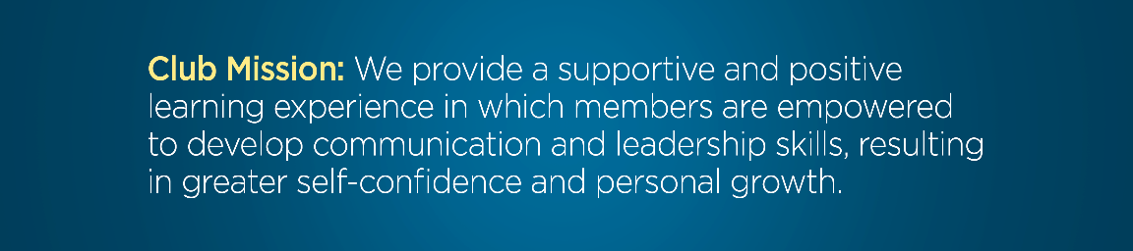
The Toastmasters club experience
Hands-on learning environment
Practice prepared and impromptu speeches
Opportunities to lead at
every meeting
Receive feedback and evaluations
in a supportive environment
Access to a mentor
Notes:
Our club meets *insert how often your club meets*. The club is a self-paced, hands-on learning environment that provides you with opportunities to give both prepared and impromptu speeches. After you give your speech, you will receive honest, encouraging and structured evaluations and will have the ability to implement the feedback in a later speech. Each meeting has volunteer leadership roles, including the Toastmaster, Evaluator, Ah-Counter, and Grammarian. Plus, you will have access to a mentor, who can help and offer advice.

Slide 5

What is the Pathways learning experience?
Pathways is Toastmasters’ education program
Each member receives one free path to start
Choose from 11 paths based on your goals
Use Pathways online or in print
Work at your own pace
Build professional skills
Notes:
The Pathways learning experience is Toastmasters’ education program. Pathways focuses on five core competencies and 11 specialized learning paths, with more to come. Each member receives one free path to start, and they are able to work on multiple paths at the same time. When you first log into Base Camp, which is the home of Pathways, you can take an assessment that will recommend three paths for you. You are free to choose any path you want! All resources and projects are available online or in print. Best of all, you can work at your own pace and along the way, you will build professional skills. The combination of the Pathways learning experience with the supportive environment found in our club is what makes Toastmasters such a powerful tool.
*Pathways is available in Arabic, English, French, German, Japanese, Korean, Portuguese, Simplified Chinese, Spanish, Tamil, and Traditional Chinese. If any of these alternative languages apply to your club, mention their availability*

Slide 6
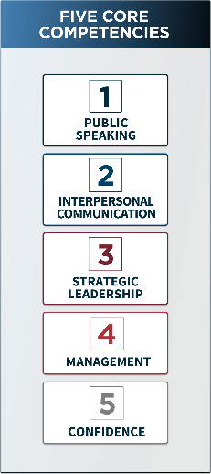
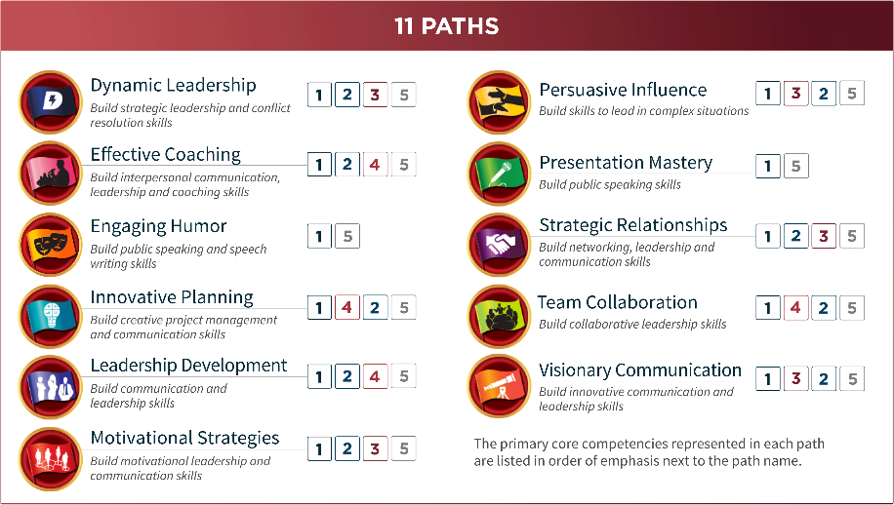
A glimpse into Pathways
Notes:
Here’s a glimpse into what Pathways looks like, the current 11 paths and the five core competencies. The five core competencies are Public Speaking, Interpersonal Communication, Strategic Leadership, Management, and Confidence. Confidence is unique because it cannot be taught, but is gained in every path. In each path, you learn multiple competencies. For example, if you wanted to work on your Public Speaking, Interpersonal Communication, and Management, the Leadership Development path is right for you. Or, if you wanted to learn about Persuasive Influence, the core competencies you would learn are Public Speaking, Strategic Leadership, and Interpersonal Communication. In all of these paths, there are over 300 competencies you can learn.

Slide 7

How the evaluation process works
Notes:
Here’s a preview of what the evaluation form looks like. You are evaluated on skills such as vocal variety, eye contact, gestures, and comfort level. Each skill has clearly outlined criteria that correspond to a number score, ranging from one to five. It is important to note that a score of three means that you met the criteria, did what you were supposed to do, and did it well. There’s also room for the evaluator to write any comments they have. These evaluations are a great tool to learn what areas you need to improve on and which you excel at, as well as allowing you to actually track your progress and growth.

Slide 8
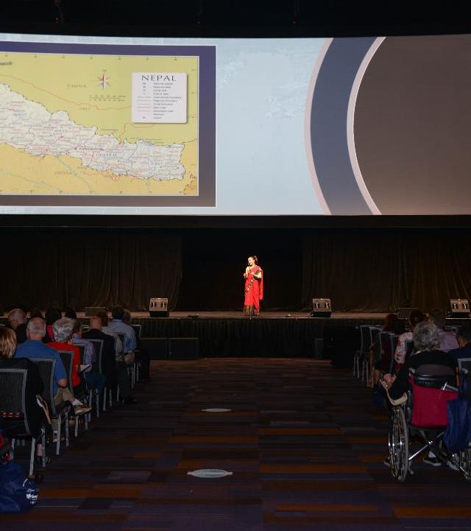
Learning doesn’t stop at the club
Subscription to the Toastmaster magazine
Speech contests
International Convention
District conferences
Access to helpful resources at www.toastmasters.org
Notes:
The learning doesn’t stop at the club. Active members receive a subscription to the Toastmaster magazine, which is filled with guidance on public speaking, leadership, featured articles on fellow Toastmasters, and much more. Toastmasters offers the opportunity to compete in a speech contest, which culminates in finalists competing in the World Championship of Public Speaking®. This contest is held at the Toastmasters International Convention, which also features education sessions and a chance to cast your club’s vote on important business matters at the Annual Business Meeting. We also provides district conferences, where you can meet fellow Toastmasters in the area and connect with them. There’s also a lot of helpful resources for you to access if you visit the Toastmasters website.

Slide 9
Break barriers, not your budget
Compared to conferences and seminars, Toastmasters is ongoing and affordable
Most cost-effective way to learn
$20 USD new-member fee
per person
$45 USD six months’ membership dues per person
[Insert any additional club dues]
Dale Carnegie three-day seminars start at $1,795 USD per person
$100
Toastmasters
Dale Carnegie
Notes:
Clubs are inexpensive to join, and unlike other programs, the learning never stops. Toastmasters offers the most cost-effective way to learn and no other company offers what we offer in the same model. There is a one-time $20 USD fee for new members and then after that, membership costs are only $45 USD for six months. Our club also has an additional charge of *insert charge here*. Toastmasters allows you to break down barriers, while not breaking your budget. Meanwhile, companies like Dale Carnegie have three-day seminars with limited learning potential and cost nearly $2,000 USD.

Slide 10
A preview of the club experience
[Presenter name]
[Speech topic or title]
[How long in Toastmasters?]
[Any leadership roles held?]
[Recognition status]
Notes:
*Note: use this slide to welcome your club member who will be presenting a speech at the meeting. Give time afterwards to have an evaluator evaluate their speech so prospective members can feel what the club experience is truly like. You may also take some time to partake in Table Topics. Make sure you call on some of your guests to speak!*

Slide 11

Ready to join?
Here’s how!
Speak with the Vice President Membership, [Name of VP]
Complete the Application for Membership
Return the completed application
with your dues to the Vice President Membership
Notes:
*Add your club’s VP Membership’s name. Feel free to add their contact information as well so guests can reach out to them with any questions or comments they have. *
Are you ready to join our club? Start by speaking with our Vice President Membership and completing the application. When you’re done, return the completed application with your dues and you’re ready to enjoy the numerous benefits of being a Toastmaster!

